Slide 1

Music Genre Classification
By: Ashraf Abdulkhlaiq | Hamza Al-Habash | Ammar Abushukur

Slide 2





data description
artist: Name of the Artist.
song: Name of the Track.
popularity: The higher the value the more popular the song is.
danceability: Describes how suitable a track is for dancing based on a combination of musical elements including tempo, rhythm.
energy: A measure from 0.0 to 1.0 and represents a perceptual measure of intensity and activity.
key: The key the track is in. Integers map to pitches using standard Pitch Class notation.
loudness: The overall loudness of a track in decibels (dB). Loudness values are averaged across the entire track and are useful for comparing relative.
mode: Mode indicates the modality (major or minor) of a track, the type of scale from which its melodic content is derived. Major is represented by 1 and minor is 0.

Slide 3
data description
speechiness: Speechiness detects the presence of spoken words in a track. The more exclusively speech-like the recording (e.g. talk show, audio book, poetry), the closer to 1.0 the attribute value.
acousticness: A confidence measure from 0.0 to 1.0 of whether the track is acoustic. 1.0 represents high confidence the track is acoustic.
instrumentalness: Predicts whether a track contains no vocals. "Ooh" and "aah" sounds are treated as instrumental in this context. Rap or spoken word tracks are clearly "vocal". The closer the instrumentalness value is to 1.0, the greater likelihood the track contains no vocal content. Values above 0.5 are intended to represent instrumental tracks, but confidence is higher as the value approaches 1.0.
liveness: Detects the presence of an audience in the recording. Higher liveness values represent an increased probability that the track was performed live. A value above 0.8 provides strong likelihood that the track is live.

Slide 4

data description
valence: A measure from 0.0 to 1.0 describing the musical positiveness conveyed by a track. Tracks with high valence sound more positive (e.g. happy, cheerful, euphoric), while tracks with low valence sound more negative (e.g. sad, depressed, angry).
tempo: The overall estimated tempo of a track in beats per minute (BPM). In musical terminology, tempo is the speed or pace of a given piece and derives directly from the average beat duration.
duration in milliseconds: Time of the song.
time_signature: a notational convention used in Western musical notation to specify how many beats (pulses) are contained in each measure (bar), and which note value is equivalent to a beat.
Class: Genre of the track.

Slide 5
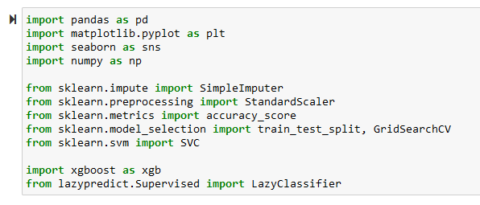
Import libraries

Slide 6
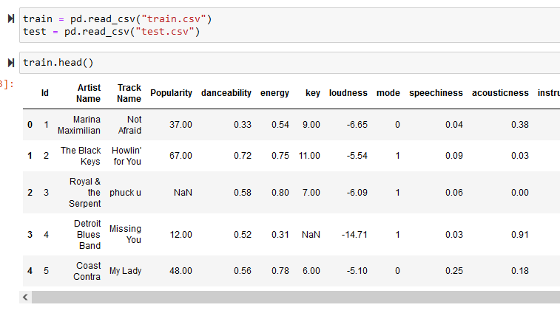

Loading data

Slide 7
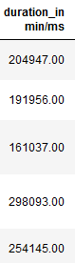
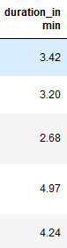
Exploratory data analysis (EDA)
First: Data Cleaning
Sorting out the unit
The duration in ms/min column had values in either ms or min units, we changed all the values to be in min using 5000 as threshold

Slide 8
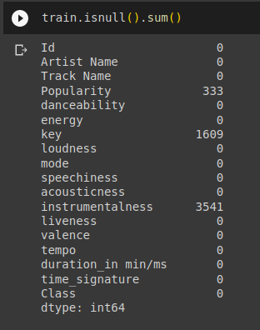
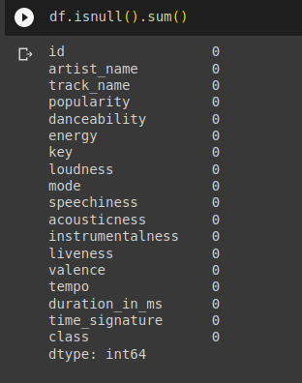
Exploratory data analysis (EDA)
First: Data Cleaning
Null Values
Imputing null values using simple imputer
Simple Imputer

Slide 9
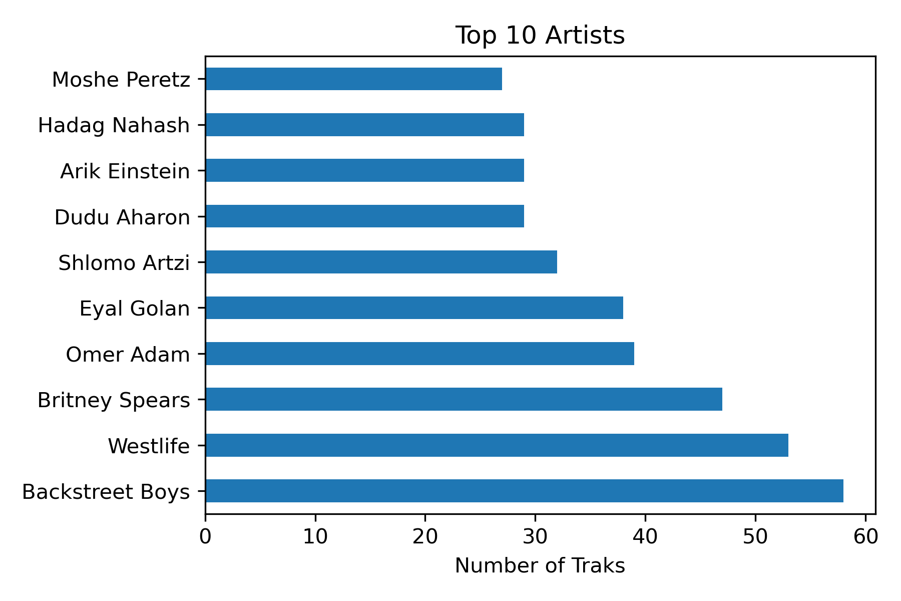
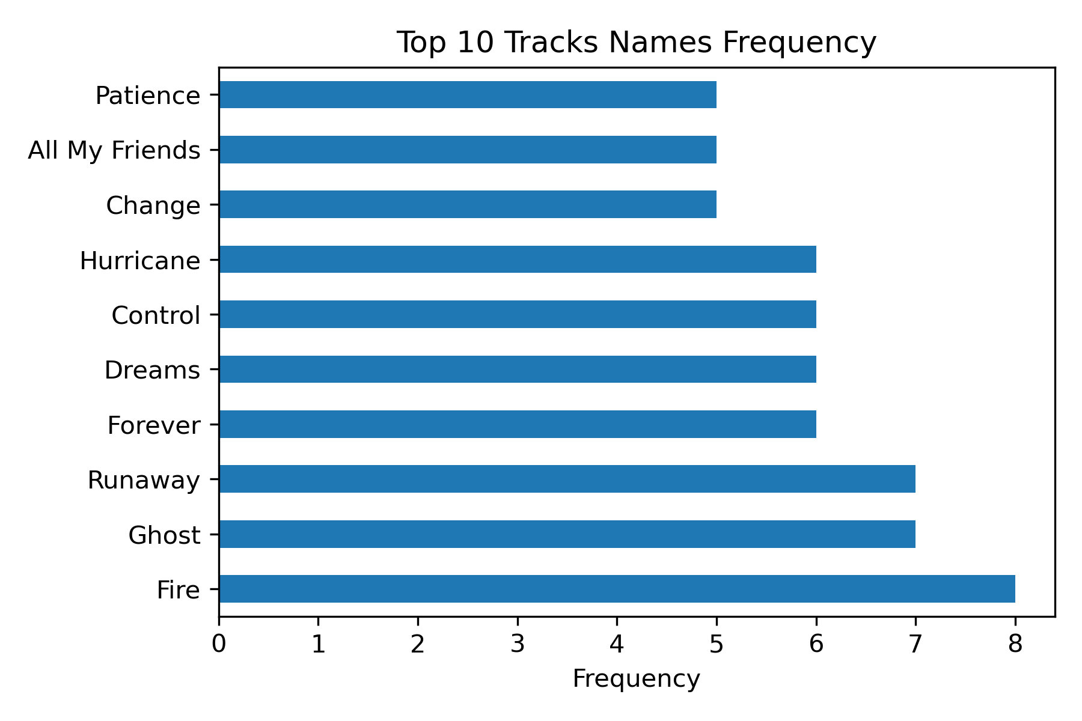
Exploratory data analysis (EDA)
Second: Data Exploring & Visualization
Bar Charts
Which artist has the highest number of tracks published?
What are the top 10 most frequent track names in the dataset?

Slide 10
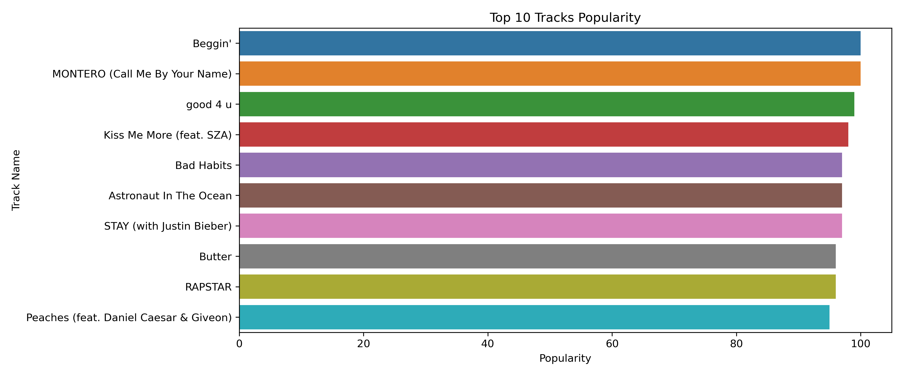
Exploratory data analysis (EDA)
Second: Data Exploring & Visualization
Bar Charts
Which track holds the highest position as the most popular among the top 10?

Slide 11
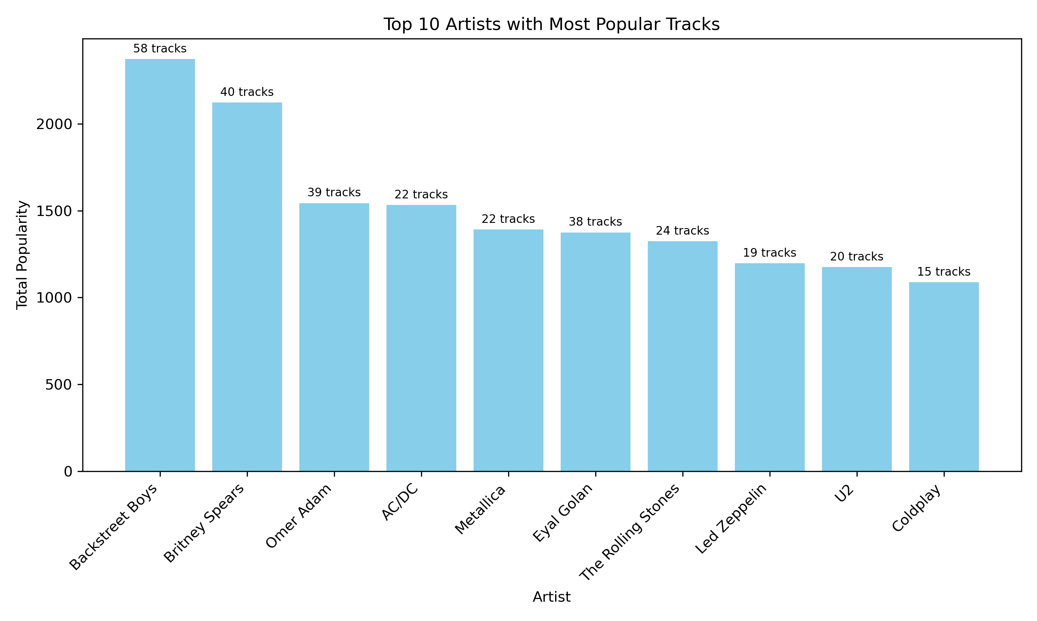
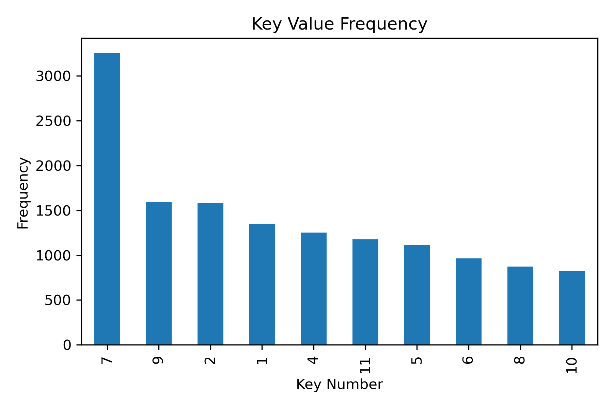
Exploratory data analysis (EDA)
Second: Data Exploring & Visualization
Bar Charts
How is the popularity of tracks determined for each artist in the dataset?
Key frequency

Slide 12
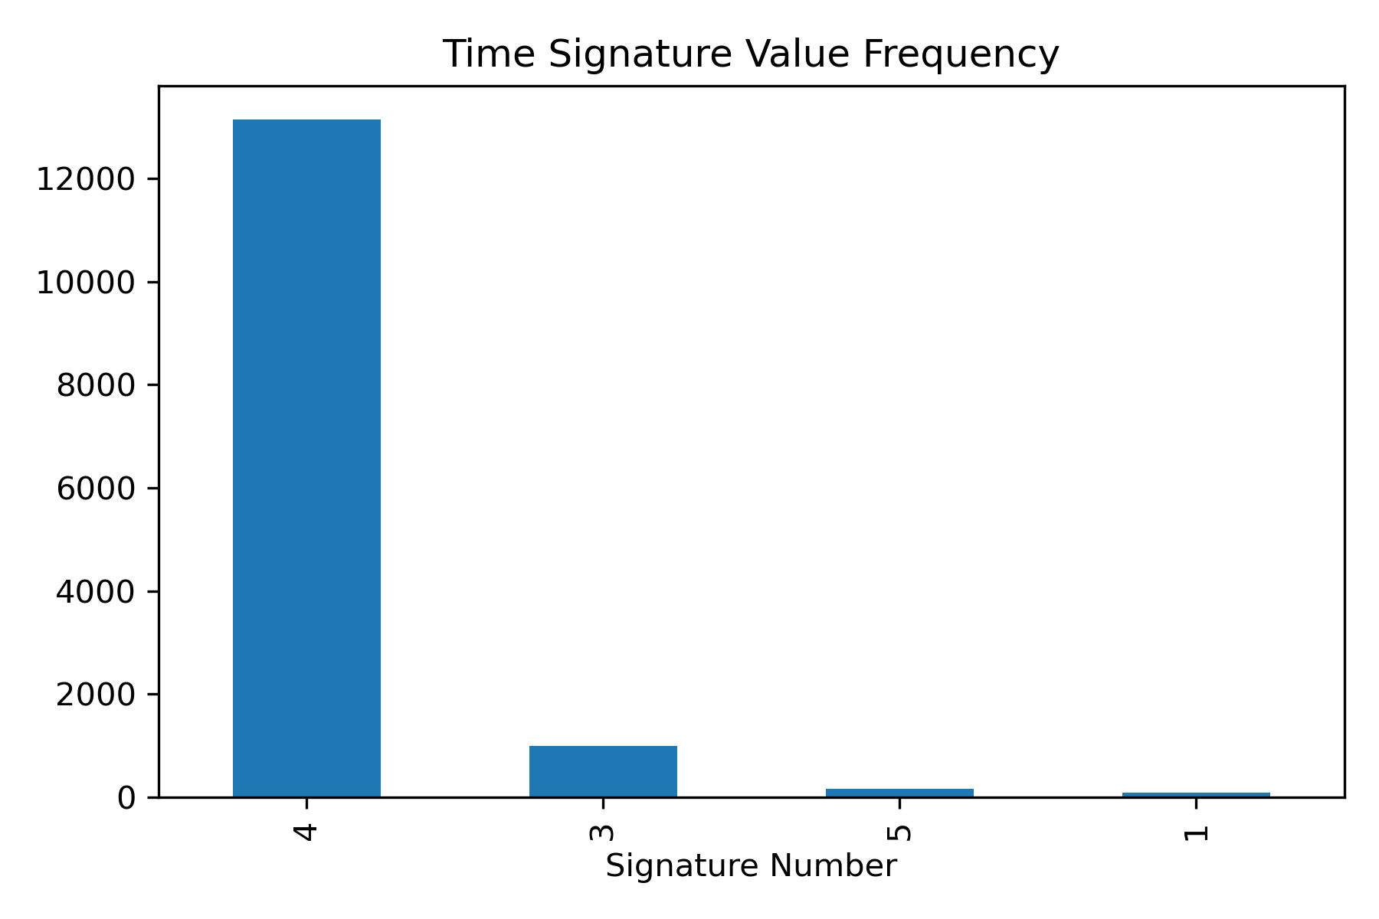
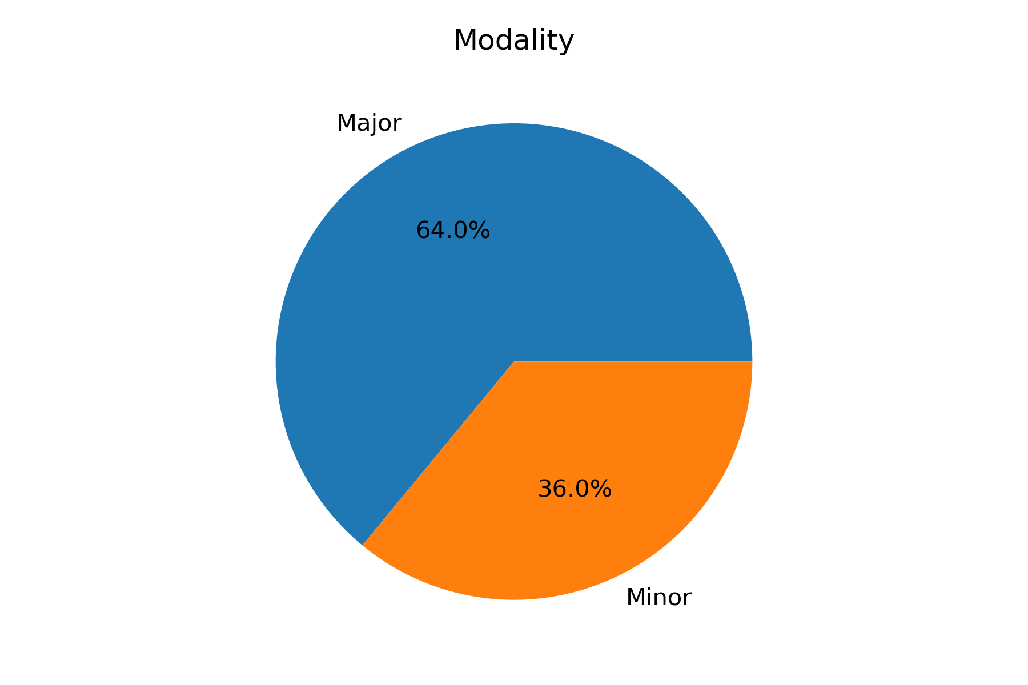
Exploratory data analysis (EDA)
Second: Data Exploring & Visualization
Bar Charts & Pie
Major represented by 1
Minor represented by 0

Slide 14
- Major represented by 1 [orange] - Minor represented by 0 [blue]

Slide 15
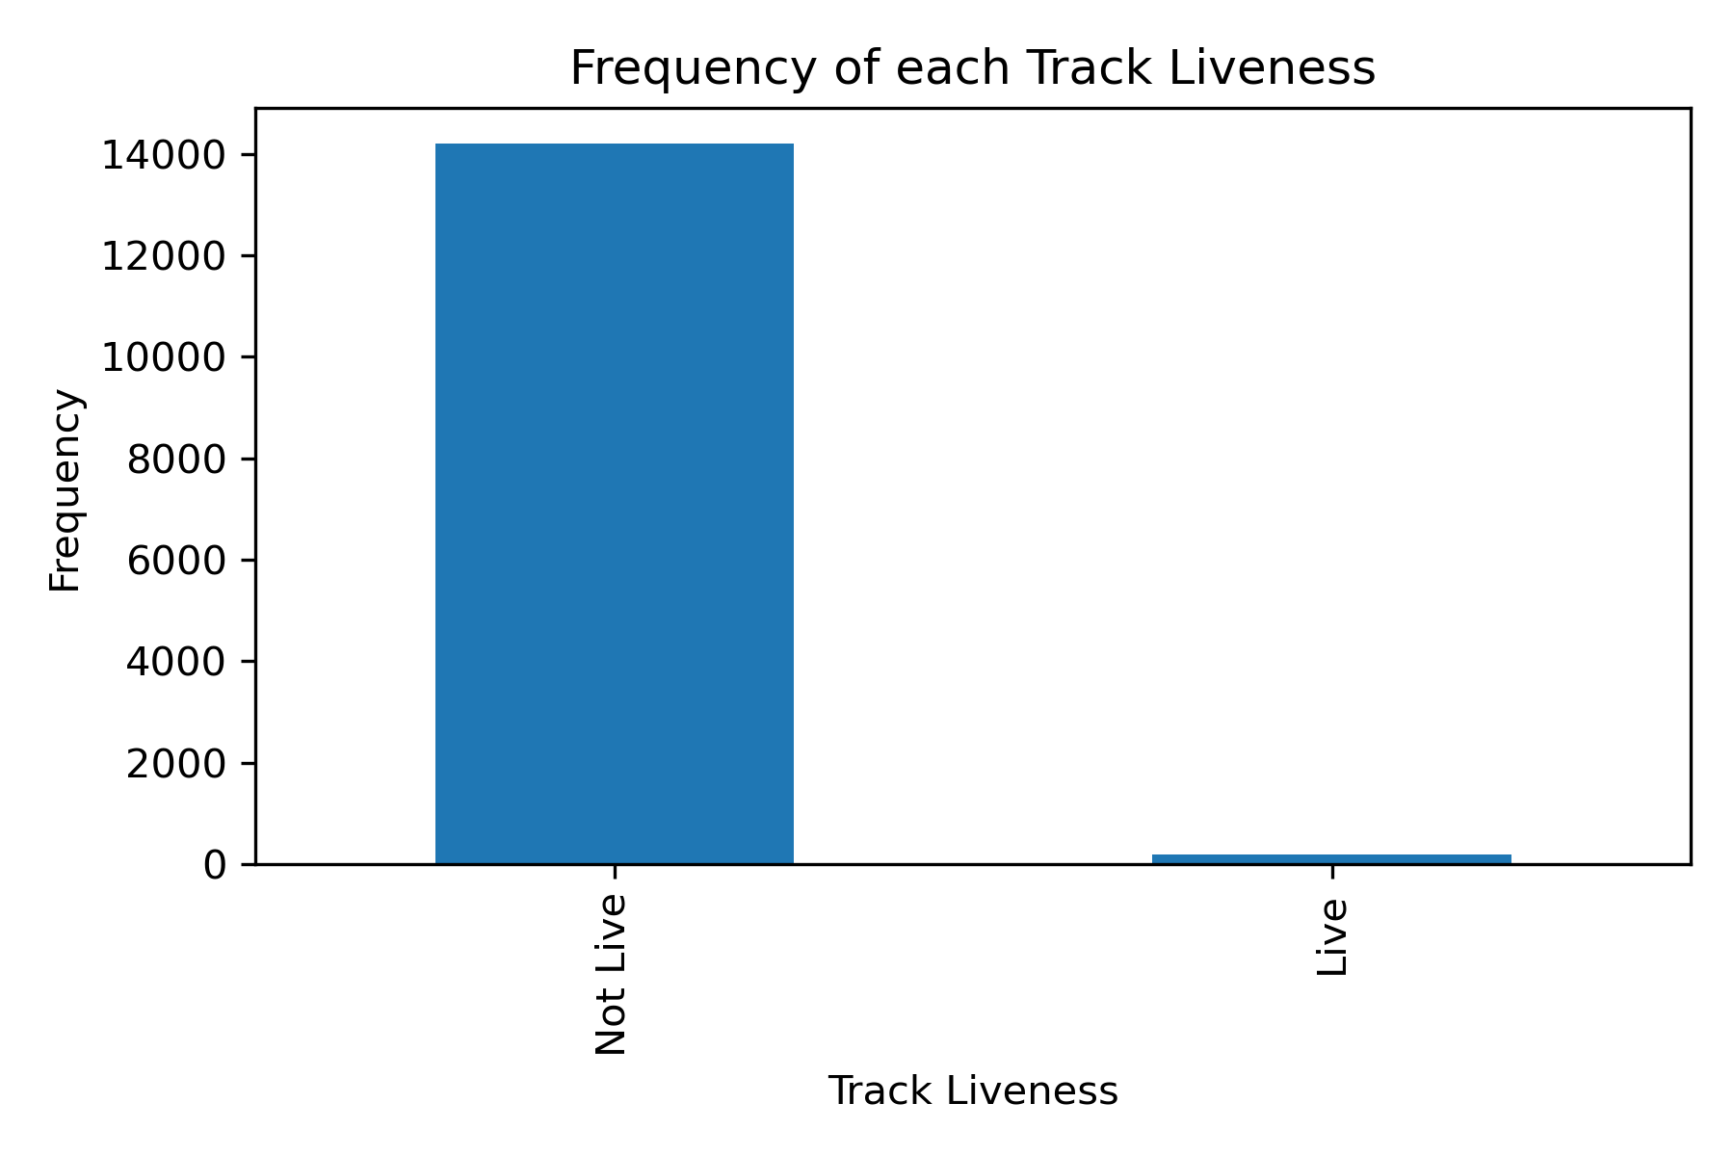
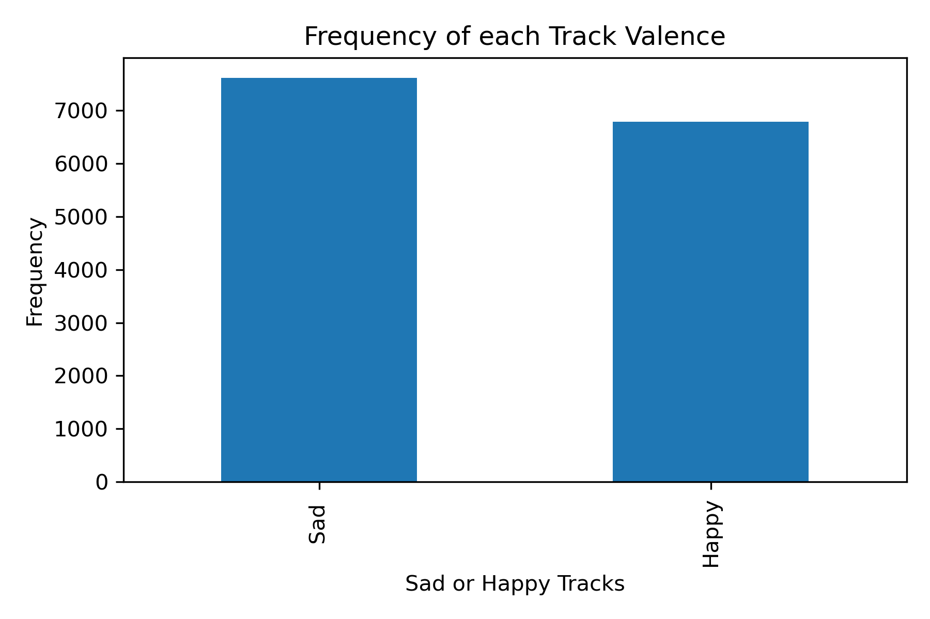
Exploratory data analysis (EDA)
Second: Data Exploring & Visualization
Bar Charts
Our data have only 195 tracks was live from total 14396 tracks.
Our data have 7614 tracks that have sad/depression tone, but in the other hand we have 6782 tracks that have happy/cheerful tone.

Slide 16
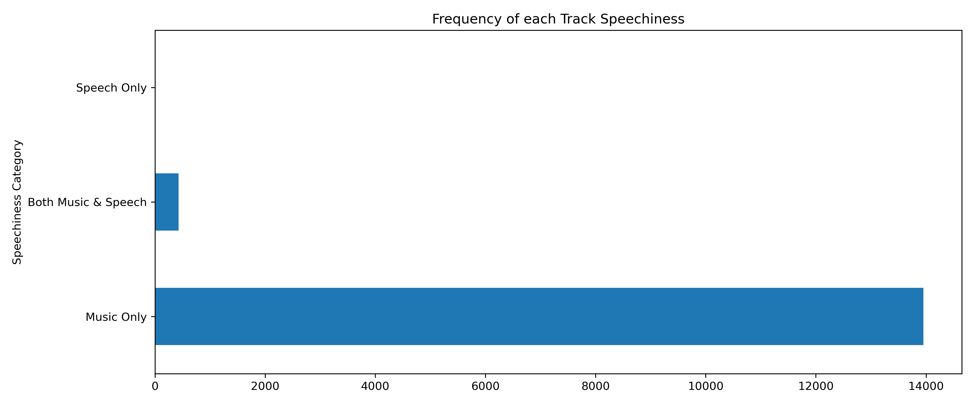
Exploratory data analysis (EDA)
Second: Data Exploring & Visualization
Bar Charts
Our data have 13953 tracks that only music, 430 tracks that music & speech and only 13 track speech.

Slide 17

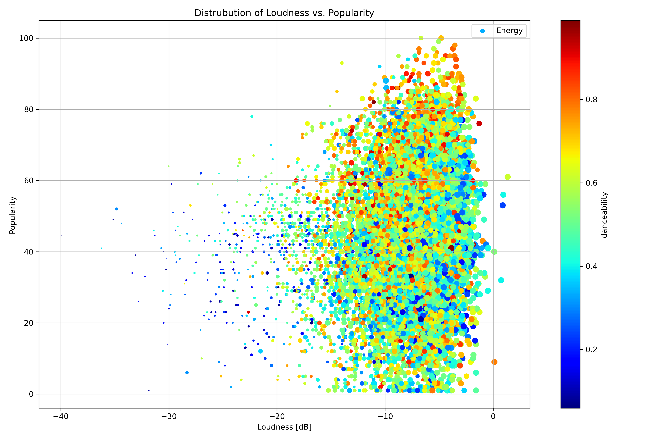
Exploratory data analysis (EDA)
Second: Data Exploring & Visualization
Scatter Plot
Is there a relationship between the loudness of a song and its popularity, and does this relationship differ based on the intensity of danceability and energy levels of the songs?

Slide 18
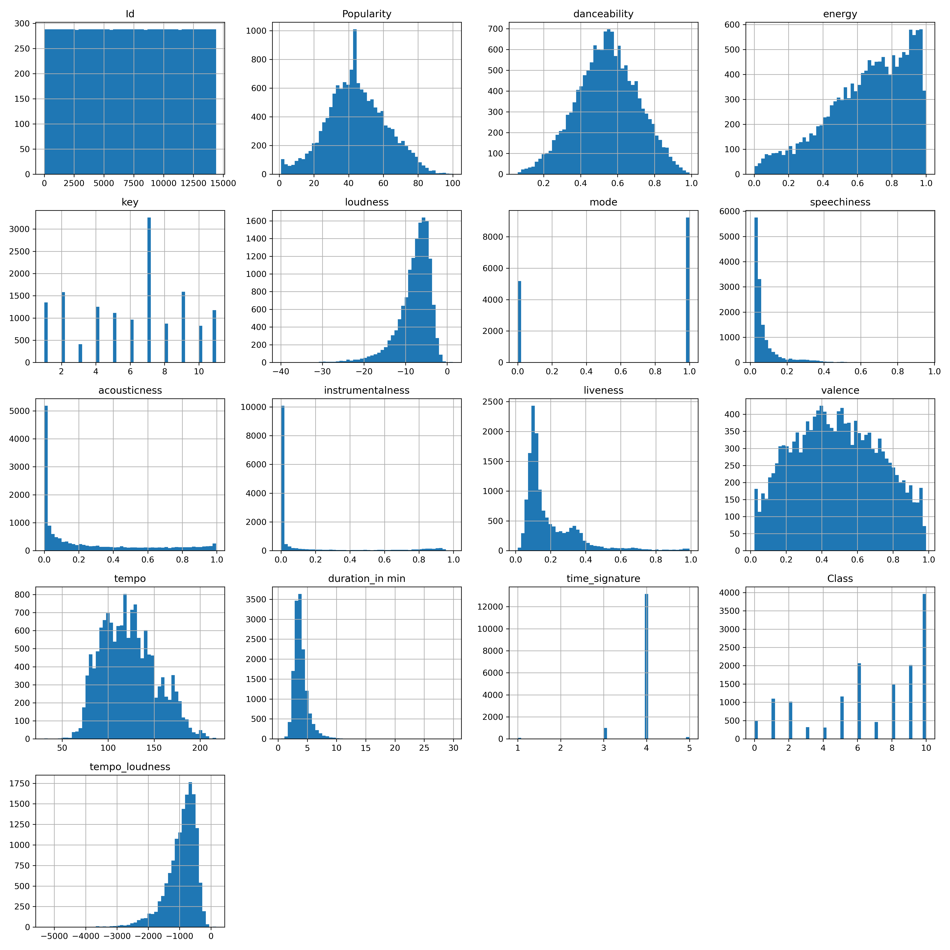
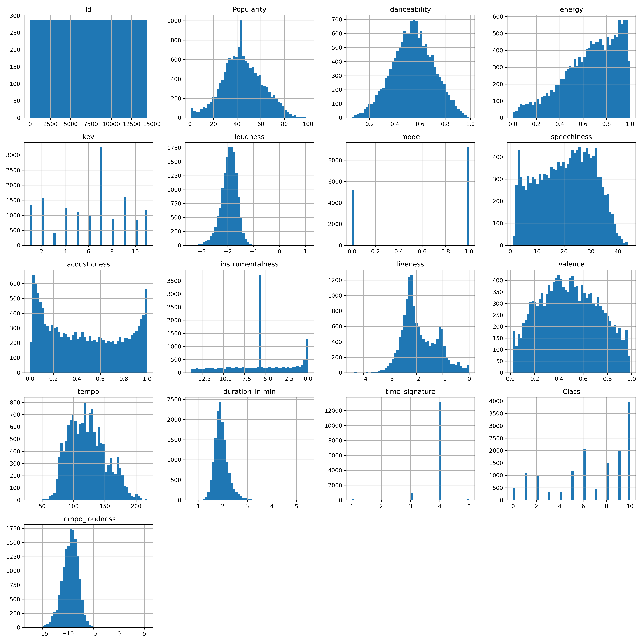
Exploratory data analysis (EDA)
Third: Data Transformations & Engineering
Making data normally distributed(Liveliness)
LOG

Slide 19
Exploratory data analysis (EDA)
Third: Data Transformations & Engineering
Making data normally distributed (Duration in min)
SQRT

Slide 20
Exploratory data analysis (EDA)
Third: Data Transformations & Engineering
Making data normally distributed (Loudness) with scaling
CBRT

Slide 21
Exploratory data analysis (EDA)
Third: Data Transformations & Engineering
Making data normally distributed(Speechiness)
Reciprocal

Slide 22
Exploratory data analysis (EDA)
Third: Data Transformations & Engineering
Making data normally distributed(Acousticness)
CBRT

Slide 23
Exploratory data analysis (EDA)
Third: Data Transformations & Engineering
Making data normally distributed(Instrumentalness)
LOG

Slide 24
Exploratory data analysis (EDA)
Third: Data Transformations & Engineering
Our model underfit at first, so we decided to make a new polynomial feature consisting of tempo times loudness which gave better results
CBRT

Slide 25
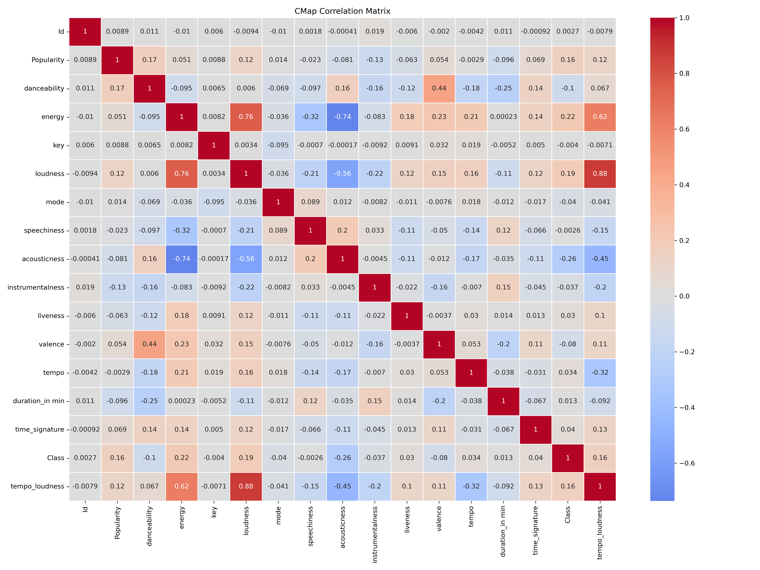
EDA
Correlation heatmap
The correlation between features ranges from -1 to 1, where negative values indicate negative correlation, positive values imply positive correlation, and 0 represents no correlation. Higher values indicate stronger correlations, regardless of their direction (positive or negative). The redness of the box is correlated with the values.
What correlations can we conclude from this? Which features are strongly each others?

Slide 26
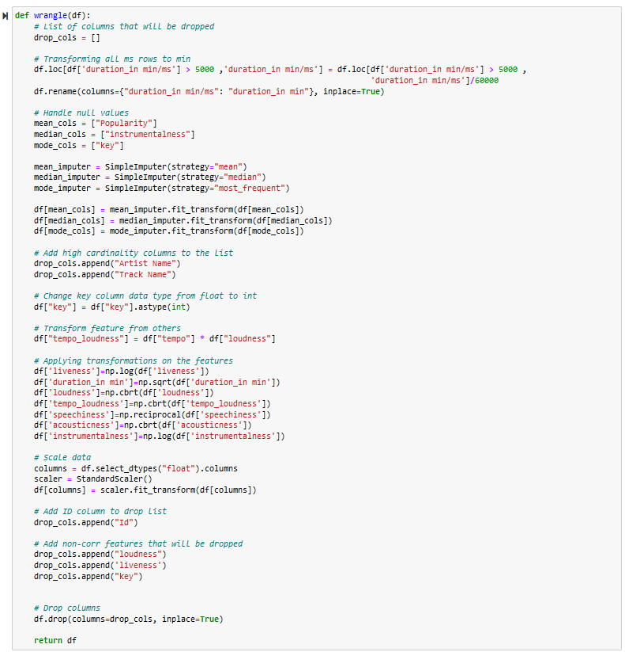

EDA
Wrangle Function
To clean and prepare our data in one step!

Slide 27
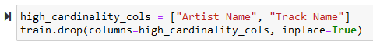
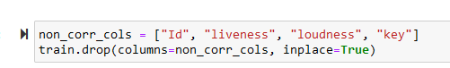
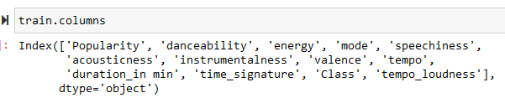
Model Selection & training
Features Selection
Dropping high cardinality columns, non/high correlation columns

Slide 28
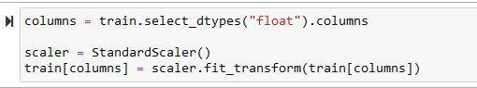
Model Selection & training
Features Scaling
Scale continues columns using standard scaler

Slide 29
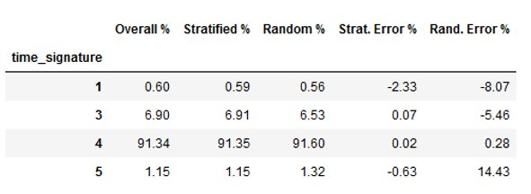
Model Selection & training
Train/Test split
Using stratifying technique, we have split our data
An unbiased evaluation is crucial to avoid introducing temporal leakage and to ensure the model's generalization to future data. The traditional random train-test split can lead to biased results, undermining the model's performance assessment. To address this, a "stratified split" based on the time signature column.

Slide 30
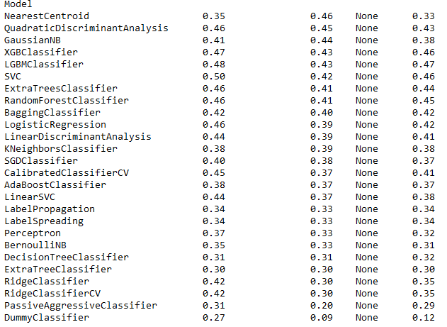
Model Selection & training
Lazy predict
Lazy Predict help build a lot of basic models without much code and helps understand which models works better without any parameter tuning

Slide 31
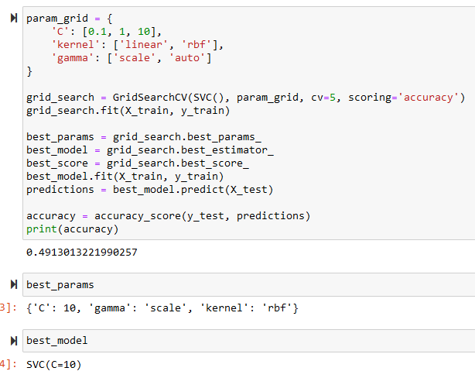
Model Selection & training
Hyperparameter Tunning
Using GridSearchCV [old run]

Slide 32
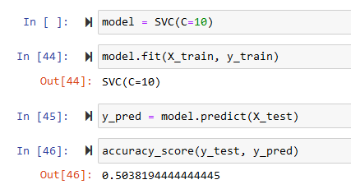
Model Selection & training
Support Vector Machine

Slide 33
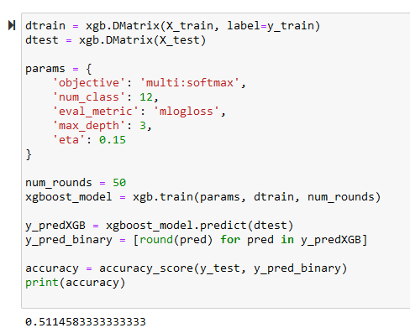
Model Selection & training
Ensemble Methods
XGBOOST

Slide 34

The way to get started is to quit talking and begin doing.
Walt Disney

Slide 35

Thank you
Ashraf Abdulkhaliq
Hamza Al-Habash
Ammar Abushukur

